Slide 1
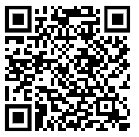
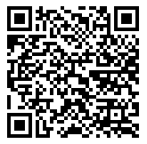
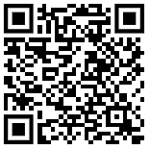
Miss Barrington will be selecting an overall winner. Entries to be in by Monday 31st March 2025.
We are taking part in a multi-school science fair! Explore the theme Change & Adapt!
Activities 5-7 year olds
Each participant will receive a Scientific Badge of honour, displaying the Ogden Trust Partnership that we are part of and a certificate. More exciting prizes to be won! Don’t delay, become a scientist!
Early Years ideas
Search the internet to seek inspiration… or look at the QR codes to the right…
To enter, simply email me a picture/video of your experiment or bring your investigation in by 31st March 2025. Emails to be sent to sciencefair@st-michaels-stone.staffs.sch.uk
Activities 7-11 year olds

